Slide 1

Team GREEN

Slide 2

Team Green
Members:
Diep Thien Thien
Le Thanh Bao
Han Trung Kien
Hoang Pham Khuong Duy
Mentor:
Le Tran Gia Vinh
Completion rate

Slide 3
Assignment
Le Thanh Bao | Design interface | 80%
Han Trung Kien | Login with social account | 75%
Diep Thien Thien | Add notes, custom note, delete, share, restore… | 90%
Hoang Pham Khuong Duy | Data authentication, add image | 75%
Members
Tasks
Completion rate

Slide 4
Content
01. Ideas
02. Introduction
03. Technologies
04. Development Process
05. Experiences

Slide 5
Timeline
Begin constructing project Memos
Assigned topic
Demo Day
March 9th
February 18th to 21th
February 18th
February 23th to March 8th
March 10th
Design Sprint
Debug
Notes:
Duy ngu nhất team

Slide 6

01
IDEAS

Slide 7
Note
Share
Easy to use
Digital note can contain media files.
Share & edit note between accounts.
.
User friendly.
Personal setting.

Slide 8
02
INTRODUCTION

Slide 9
Project’s name: Memos.
Sign up your own account.
Create & store unlimited note.
Share your notes to others.
Friendly interface with personal setting.

Slide 10
03
TECHNOLOGIES

Slide 11




Angular
Angular Material
Firebase
Node JS

Slide 12
04
DEVELOPMENT PROCESS

Slide 13
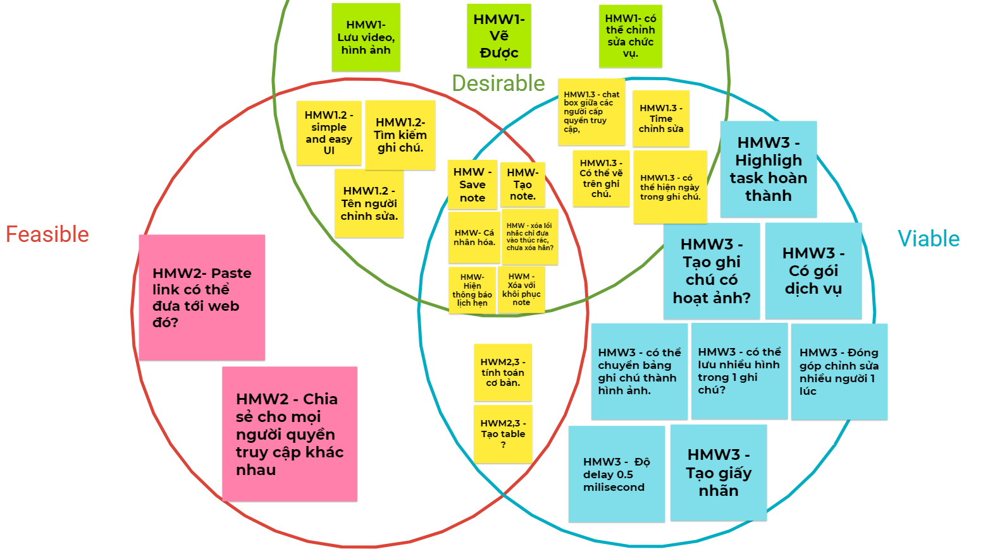

Slide 14
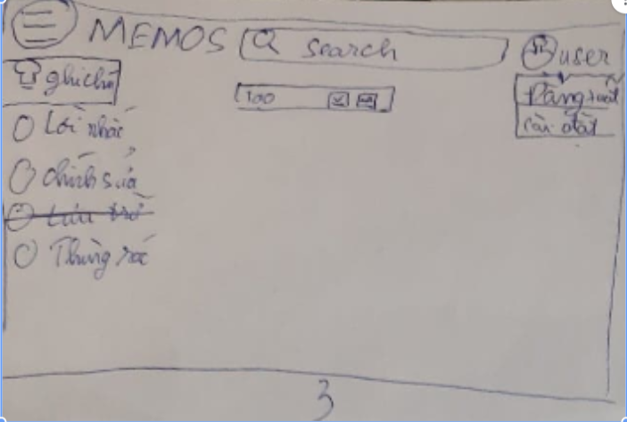
Prototype Memos’s main page
Prototypes

Slide 15
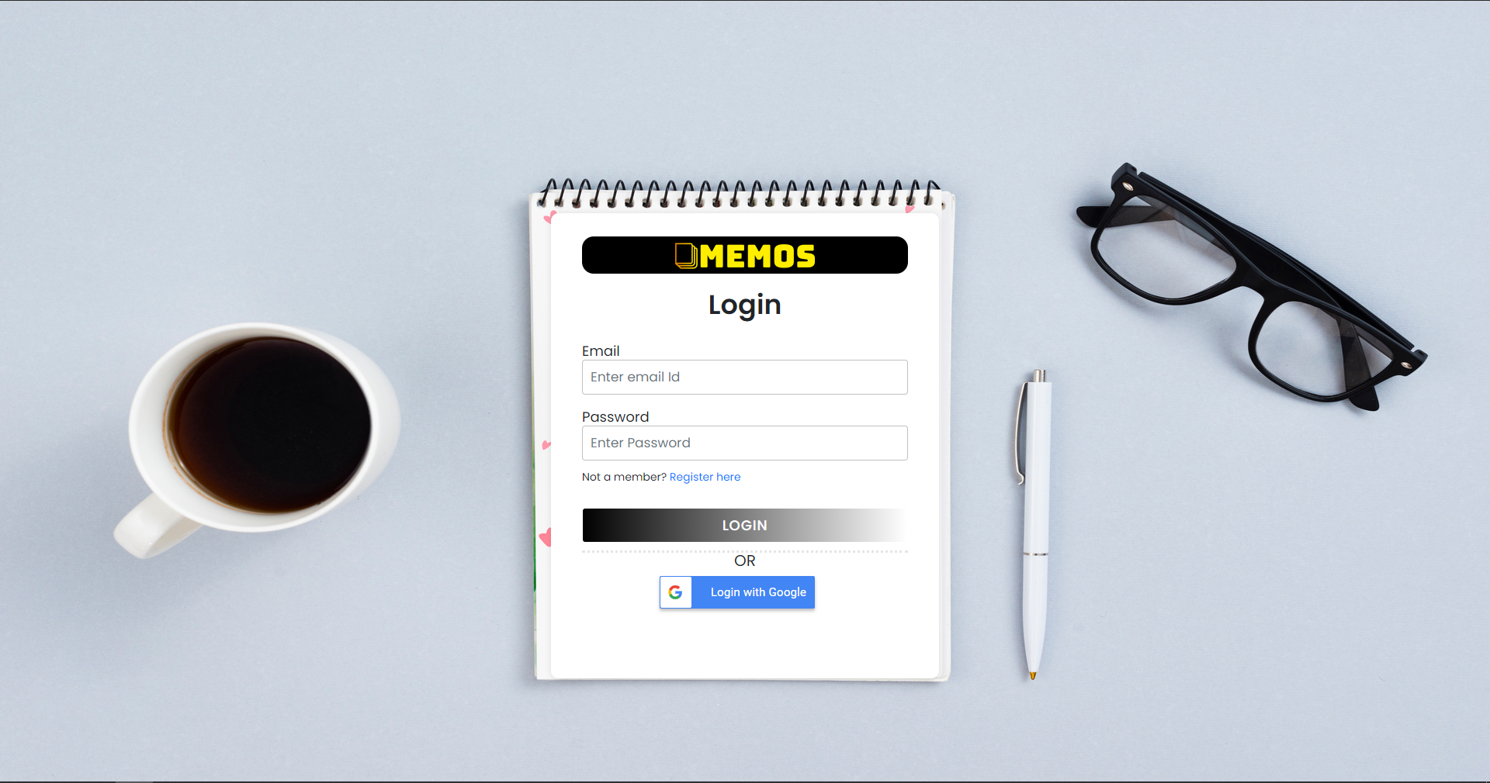
Features
Memos’s login page
(with Memos’s authentication or Google account)

Slide 16
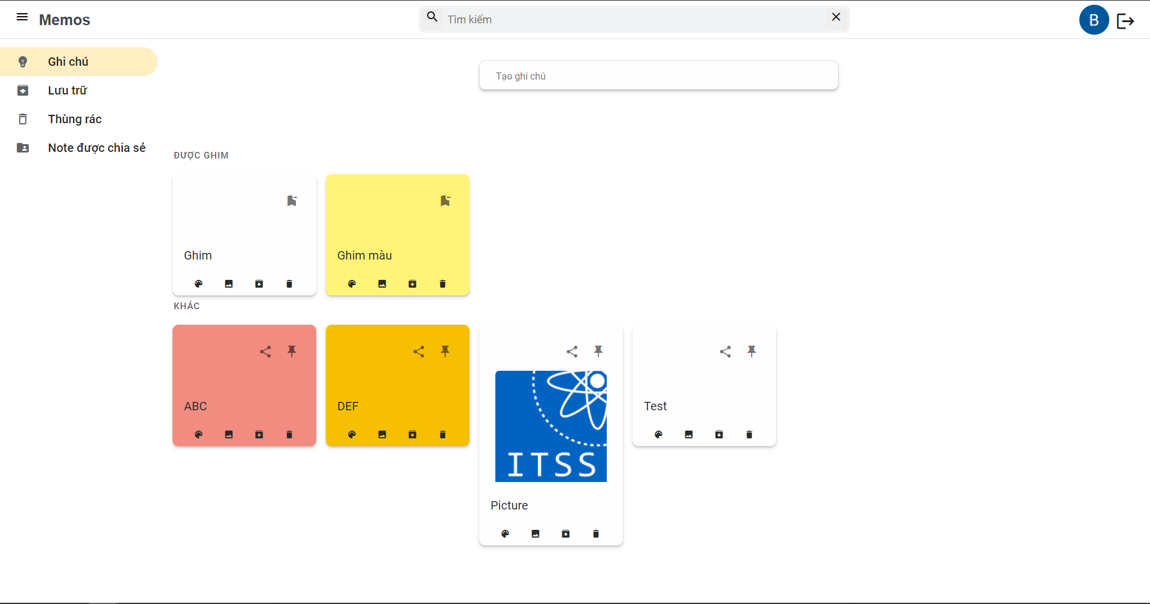
Features
Memos’s main page

Slide 17
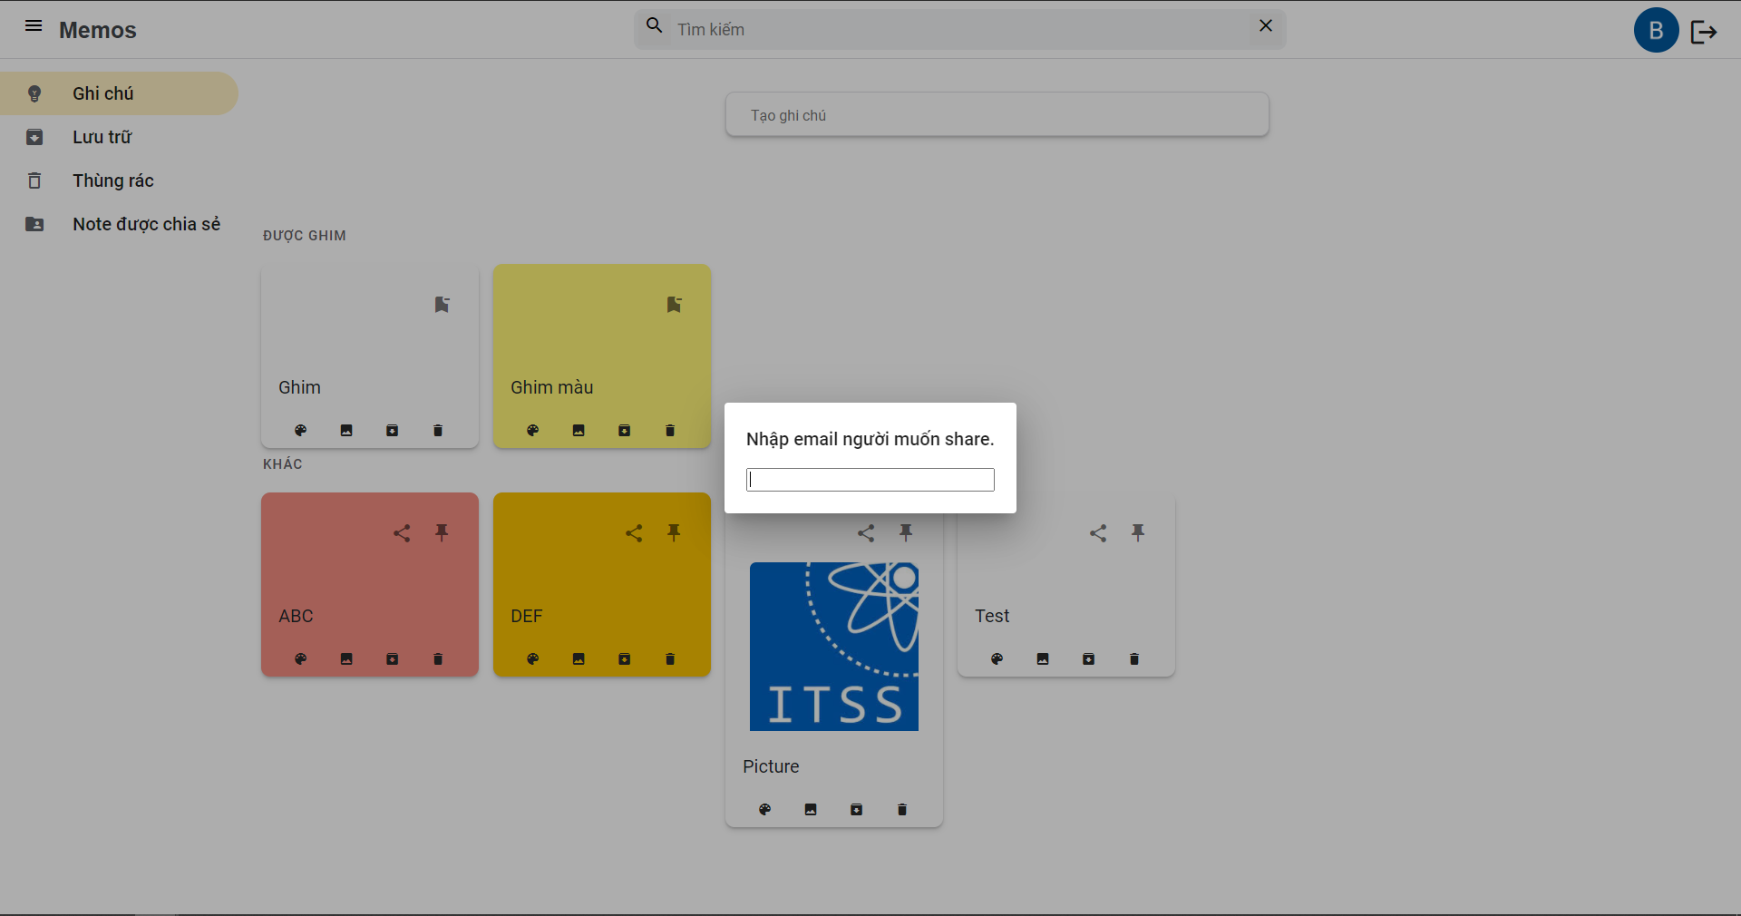
Features
Memos’s share function

Slide 18
Current Limitations
Draw function.
Add video.
Notification.
Relocation (drag & drop).
Share selected notes.

Slide 19
Demo

Slide 20
05
EXPERIENCES

Slide 21

Improve teamwork skills.
Implement Design Sprint.
Prioritize tasks in chronological order.
Try tools that benefit in different categories.

Slide 22

www.itsstraining.edu.vn

